Slide 1
UIUC BA545 Spring 2024
Peteraf, Margaret A. (1993). The cornerstones of competitive advantage: A resource- based view. Strategic Management Journal, 14(3): 179-191.
Resource- based View
Margaret Peteraf
Leon E. Williams Professor of Management, Tuck School of Business
Professor Joseph T. Mahoney

Slide 2
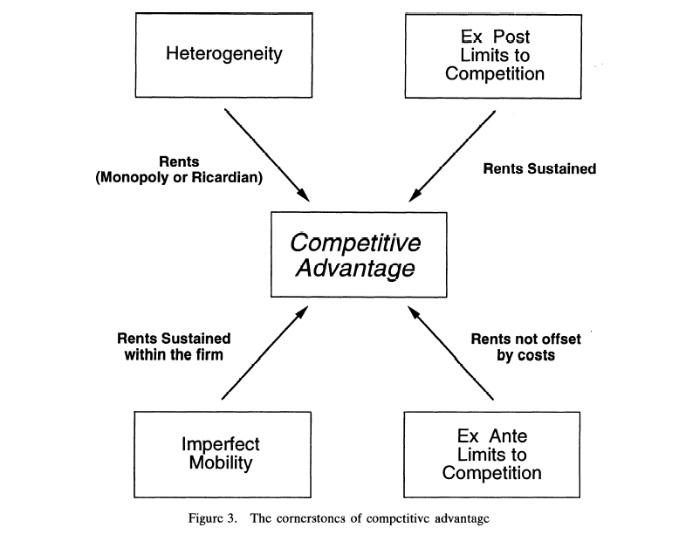
Overview
Resource-based model is still in the development stage, and there is a need for greater rigor and richness of detail.
Subtle variations in terminology across papers made communication more difficult
The underpinning model seems disjointed
Purpose:
To develop a general model of resources and firm performance, which at once integrates the various strands of research, and provides a common ground from which further work can proceed.
Four conditions that underpin competitive advantage:
Resource heterogeneity
Ex post limits to competition
Imperfect resource mobility
Ex ante limits to competition

Slide 3
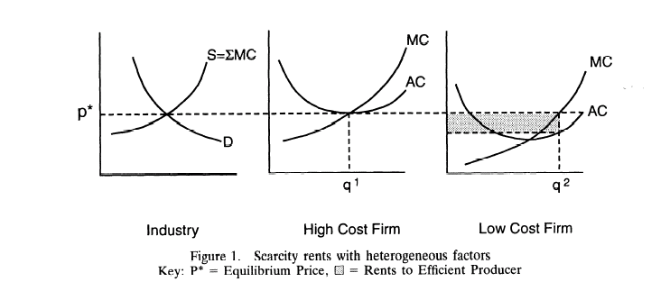
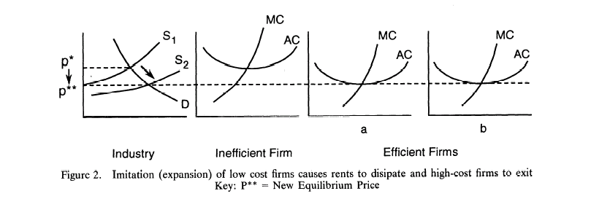
1) Heterogeneity: Ricardian Rents
03
Assumption: heterogeneous across firms.
Firms with superior resources will earn rents
Ricardian rents: Superior productive factors in limited supply (fixed or quasi-fixed) → scarce (insufficient to satisfy demand) → inferior resources are brought into production
Firms with superior resources have lower average costs than other firms.
Efficient firms can sustain this type of competitive advantage only if their resources cannot be expanded freely or imitated by other firms.
A model of competitive
advantage
Normal returns
rents

Slide 4
1) Heterogeneity: Monopoly Rents
04
Monopoly profits result from a deliberate restriction of output rather than an inherent scarcity of resource supply
In monopoly models, heterogeneity may result from spatial competition or product differentiation
Firms in favorable positions face downward sloping demand curves → restrict their outputs → maximize their profits
Homogeneous firms may also earn monopoly rents
Cournot (duopoly) behavior and collusive behavior may yield prices in excess of marginal costs
These behaviors depend on barriers to entry, which leads to heterogeneity between incumbent firms and potential entrants
A model of competitive
advantage

Slide 5
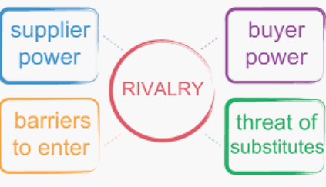
2) Ex post limits to competition
05
Durable heterogeneity for rents over a longer term ➔ ex post limits to competition
There must be forces which limit competition after a firm’s gaining a superior position and earning rents
Two critical factors that limit ex post competition:
Imperfect substitutability:
Reduce rents by making the demand curves of monopolists or oligopolists more elastic; One of Porter’s five forces
2. Imperfect imitability:
Isolating mechanisms, including property rights, quasi-rights in the form of lags, information asymmetries, frictions, causal ambiguity, producer learning, buyer switching costs, reputation, buyer search costs, channel crowding, and economies of scale
A model of competitive
advantage

Slide 6
3) Imperfect mobility
06
Resources are perfectly immobile if they cannot be traded
Resources are imperfectly immobile when they are somewhat specialized to firm-specific needs
Causes
Switching costs (due to firm-specific investments)
Co-specialized assets
High transaction costs associated with the transfer
Key features (making imperfect mobility necessary for SCA)
Remain available/bound to the firm
Rents are shared by the firm
A model of competitive
advantage

Slide 7
4) Ex ante limits to competition
07
There must be limited competition for the superior resource position before any firm establishes itself in that position.
Keep costs from offsetting the rents
A model of competitive
advantage

Slide 8
08
The cornerstones of competitive advantage
Resource heterogeneity creates Ricardian or monopoly rents
Ex post limits to competition prevent the rents from being competed away
Imperfect factor mobility ensures that valuable factors remain with the firm and that the rents are shared
Ex ante limits to competition keep costs from offsetting the rents
→ Four conditions that must be met for sustained above-normal returns

Slide 9
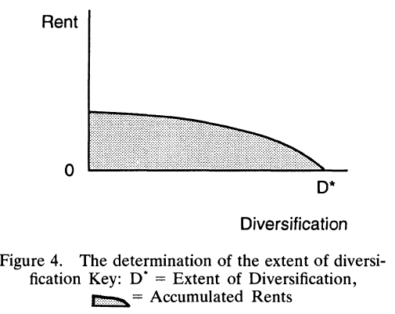
Applications
09
1. Single business strategy
By analyzing his resource position, a manager can have a clearer understanding of whether his situation meets necessary conditions for a sustainable advantage.
Made correct strategic decision (ex. license a new technology or develop internally?)
2. Corporate strategy
The scope of the firm
Diversification: ➔ the result of excess capacity in resources which have multiple uses and for which there is market failure
The model implies an optimal extent of diversification: when rents – which diminish with each added market due to efficiency loss – in the final added market reach 0
Applications of the resource-based
model

Slide 10
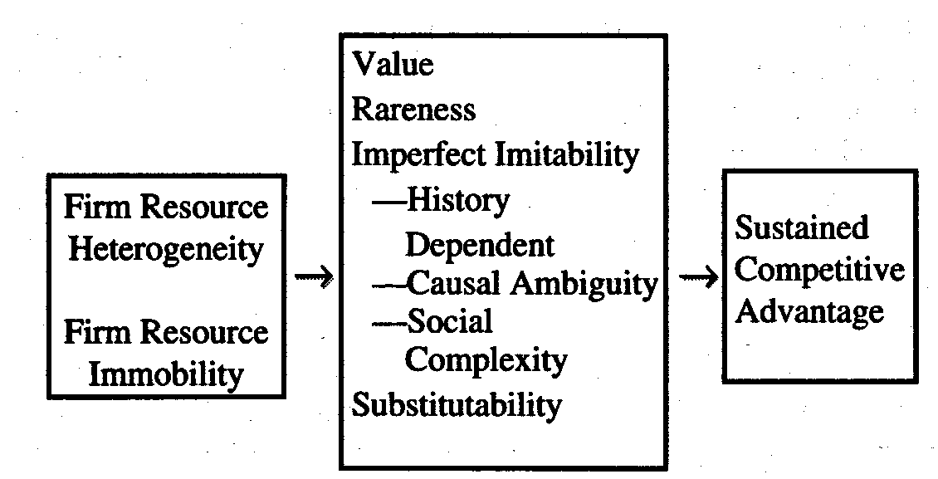
Comparison with Barney’s model
10
Discussion
Peteraf (1993)
Barney (1991)

